Slide 1
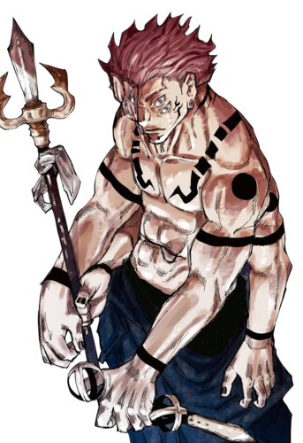
RYOMEN SUKUNA RYOMEN SUKUNA, often referred to as the King of Curses, is a legendary figure from the anime and manga Jujutsu KAISEN. His origins date back to the Heian Era (794–1185 AD), a period in Japanese history known as the "Golden Age of Jujutsu Sorcery." During this time, sorcerers and curses were at their peak, and Sukuna emerged as one of the most powerful and terrifying beings of his era.

Slide 2
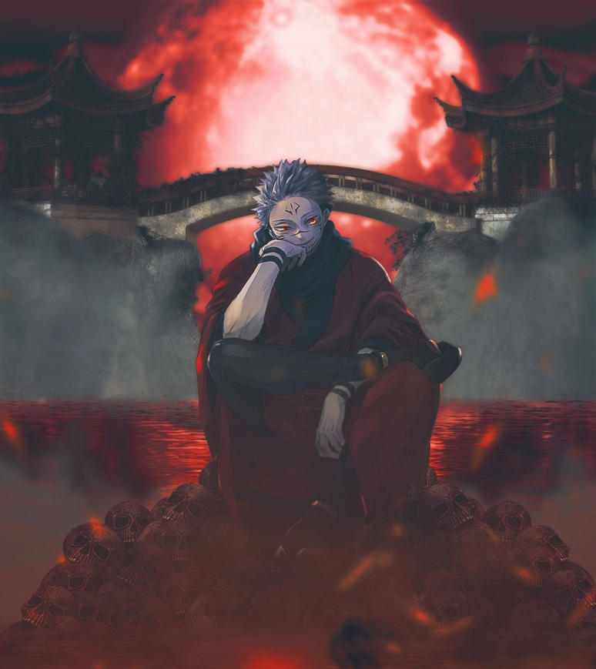
Origins and Lifestyle SUKUNA was originally a human sorcerer, but not just any sorcerer—he was an exceptional one, feared by both humans and cursed spirits alike. In life, SUKUNA was a cruel, malevolent figure, known for his brutality and unquenchable thirst for power. He delighted in destruction and domination, leaving chaos in his wake. His violent, sadistic nature earned him a fearsome reputation, and many sought to defeat him, but none could match his overwhelming strength. After his death, SUKUNA'S cursed energy was so immense that his body could not be COMPLETELY DESTROYED. His remains were divided into 20 indestructible fingers, each one holding a fragment of his enormous power. These fingers are cursed objects of immense value, sought after by both curses and sorcerers who wish to either control or eradicate his power. AS LONG AS his fingers exist, so does the threat of his return.

Slide 3
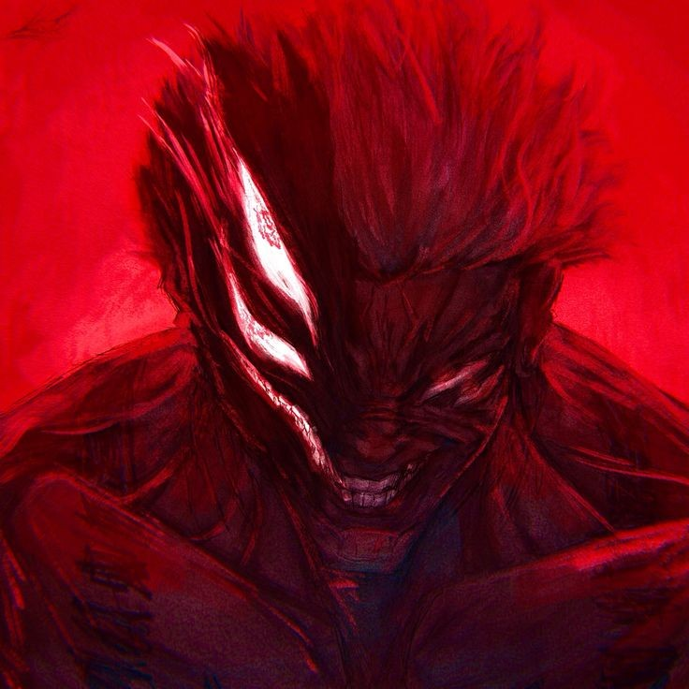
LEGACY OF FEAR EVEN CENTURIES AFTER HIS DEATH, SUKUNA'S INFLUENCE REMAINS STRONG. HIS FINGERS ARE CONSIDERED THE MOST DANGEROUS CURSED OBJECTS, AND CONSUMING THEM IS SAID TO GRANT IMMENSE POWER. HOWEVER, THIS COMES AT AGREAT RISK, AS THE SPIRIT OF SUKUNA RESIDES WITHIN HIS FINGERS, AND ANYONE CONSUMING THEM RISKS BECOMING A HOST FOR THE KING OF CURSES. IN THE SERIES, YUJI ITADORI CONSUMES ONE OF SUKUNA'S FINGERS, AND SUKUNA'S SPIRIT BECOMES PARTIALLY RESURRECTED WITHIN YUJI'S BODY. THIS SETS OFF A CENTRAL CONFLICT WHERE BOTH CURSES AND SORCERERS SEEK TO EITHER COLLECT THE REMAINING FINGERS OR STOP SUKUNA'S INEVITABLE RETURN.

Slide 4
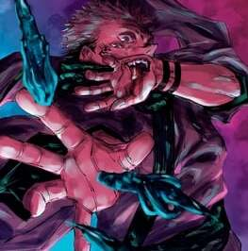
THE MEANING BEHIND THE TITLE "KING OF CURSES" SUKUNA'S TITLE, KING OF CURSES, SIGNIFIES HIS UNRIVALED DOMINANCE OVER CURSED SPIRITS. HE IS CONSIDERED THE EPITOME OF MALEVOLENT CURSED ENERGY, FAR SURPASSING ANY OTHER CURSE IN BOTH STRENGTH AND MALICE. THE TITLE REFLECTS BOTH HIS OVERWHELMING POWER AND HIS ABILITY TO CONTROL AND MANIPULATE CURSES, MAKING HIM A NEAR-MYTHICAL FIGURE WITHIN THE WORLD OF JUJUTSU SORCERY. CURSED ENERGY MASTERY: SUKUNA'S CURSED ENERGY IS ON AN UNIMAGINABLE SCALE, MAKING HIM VIRTUALLY INDOMITABLE. INTELLIGENCE AND SKILL: BEYOND RAW POWER, HE POSSESSES INCREDIBLE KNOWLEDGE AND EXPERTISE IN CURSED TECHNIQUES, MAKING HIM NOT ONLY STRONG BUT ALSO DANGEROUSLY CUNNING.

Slide 5
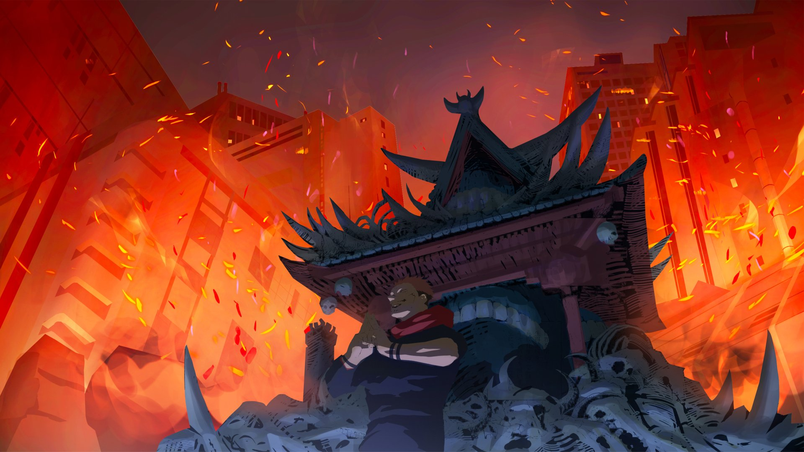
SUKUNA’S domain expansion : malevolent shrine

Slide 6
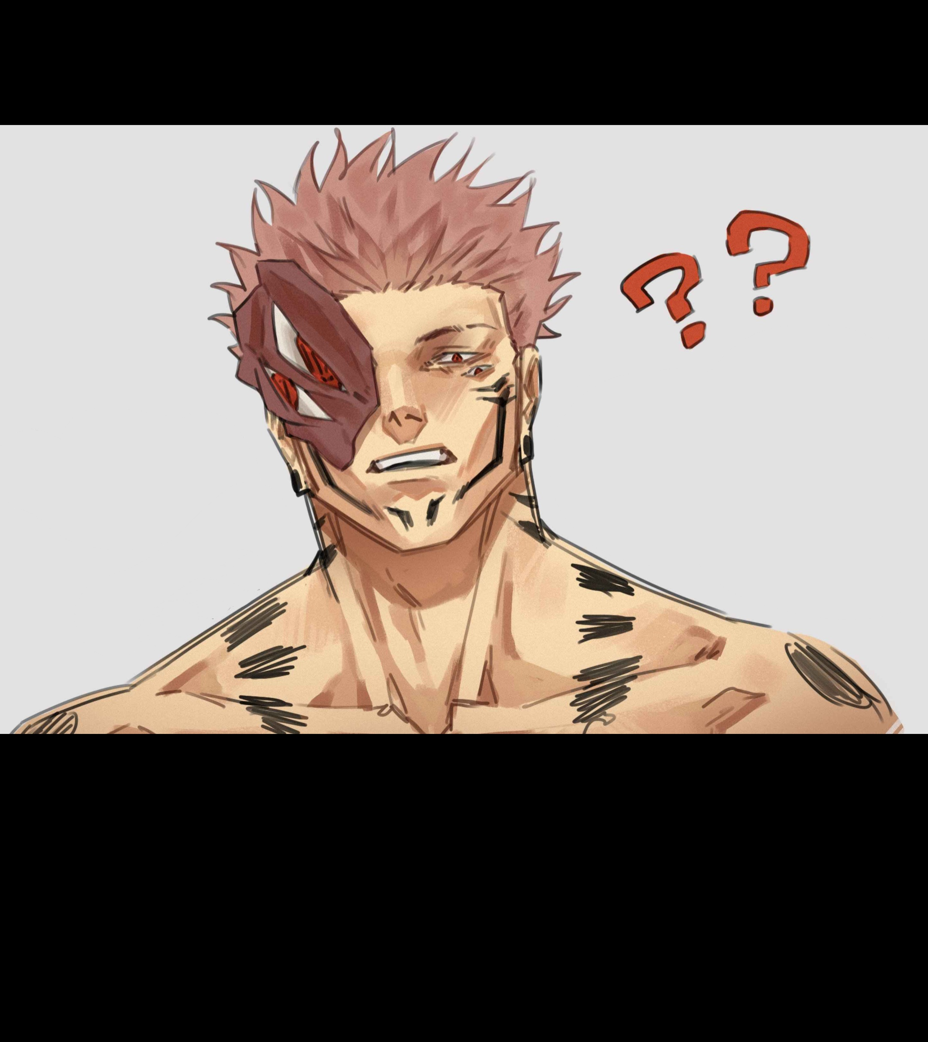
NOTORIETY AND STRENGTH SUKUNA IS KNOWN FOR HIS BRUTAL AND SADISTIC NATURE. HIS STRENGTH IS UNMATCHED, AND THROUGHOUT THE SERIES, HIS FINGERS ARE HIGHLY SOUGHT AFTER DUE TO THE SHEER POWER THEY HOLD. DESPITE HIS TERRIFYING REPUTATION, SUKUNA REMAINS CALM AND ARROGANT, OFTEN TOYING WITH HIS OPPONENTS BECAUSE HE KNOWS THAT VERY FEW, IF ANY, CAN CHALLENGE HIM. HIS DOMAIN EXPANSION: MALEVOLENT SHRINE IS ONE OF HIS MOST FEARSOME ABILITIES, WHERE HE MANIFESTS A SHRINE-LIKE STRUCTURE THAT CAN ELIMINATE ANYTHING WITHIN ITS RANGE WITH DEADLY PRECISION. IN ESSENCE, SUKUNA IS A SYMBOL OF FEAR, POWER, AND CHAOS. HIS TITLE AS THE KING OF CURSES IS NOT ONLY A REFLECTION OF HIS UNMATCHED STRENGTH BUT ALSO OF THE LEGACY OF TERROR HE LEFT BEHIND DURING HIS REIGN AS A SORCERER, AND THE CONTINUED THREAT HE POSES IN THE CURSED WORLD.

Slide 7
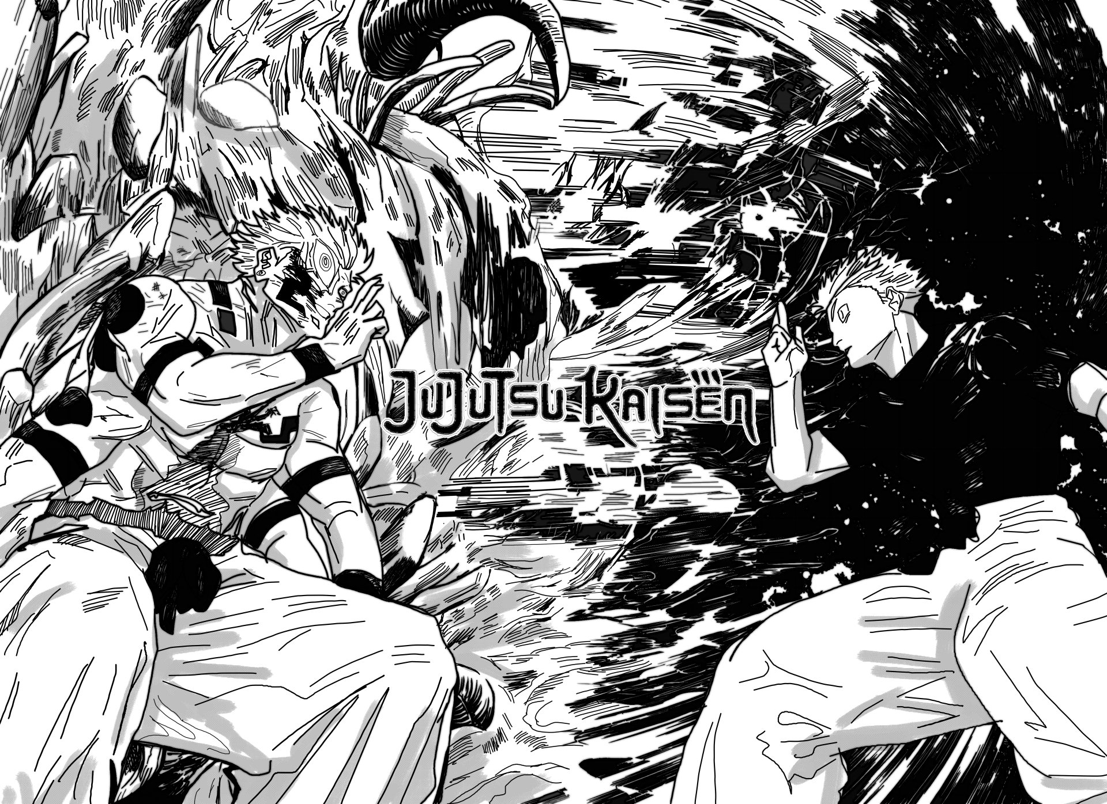

Slide 8
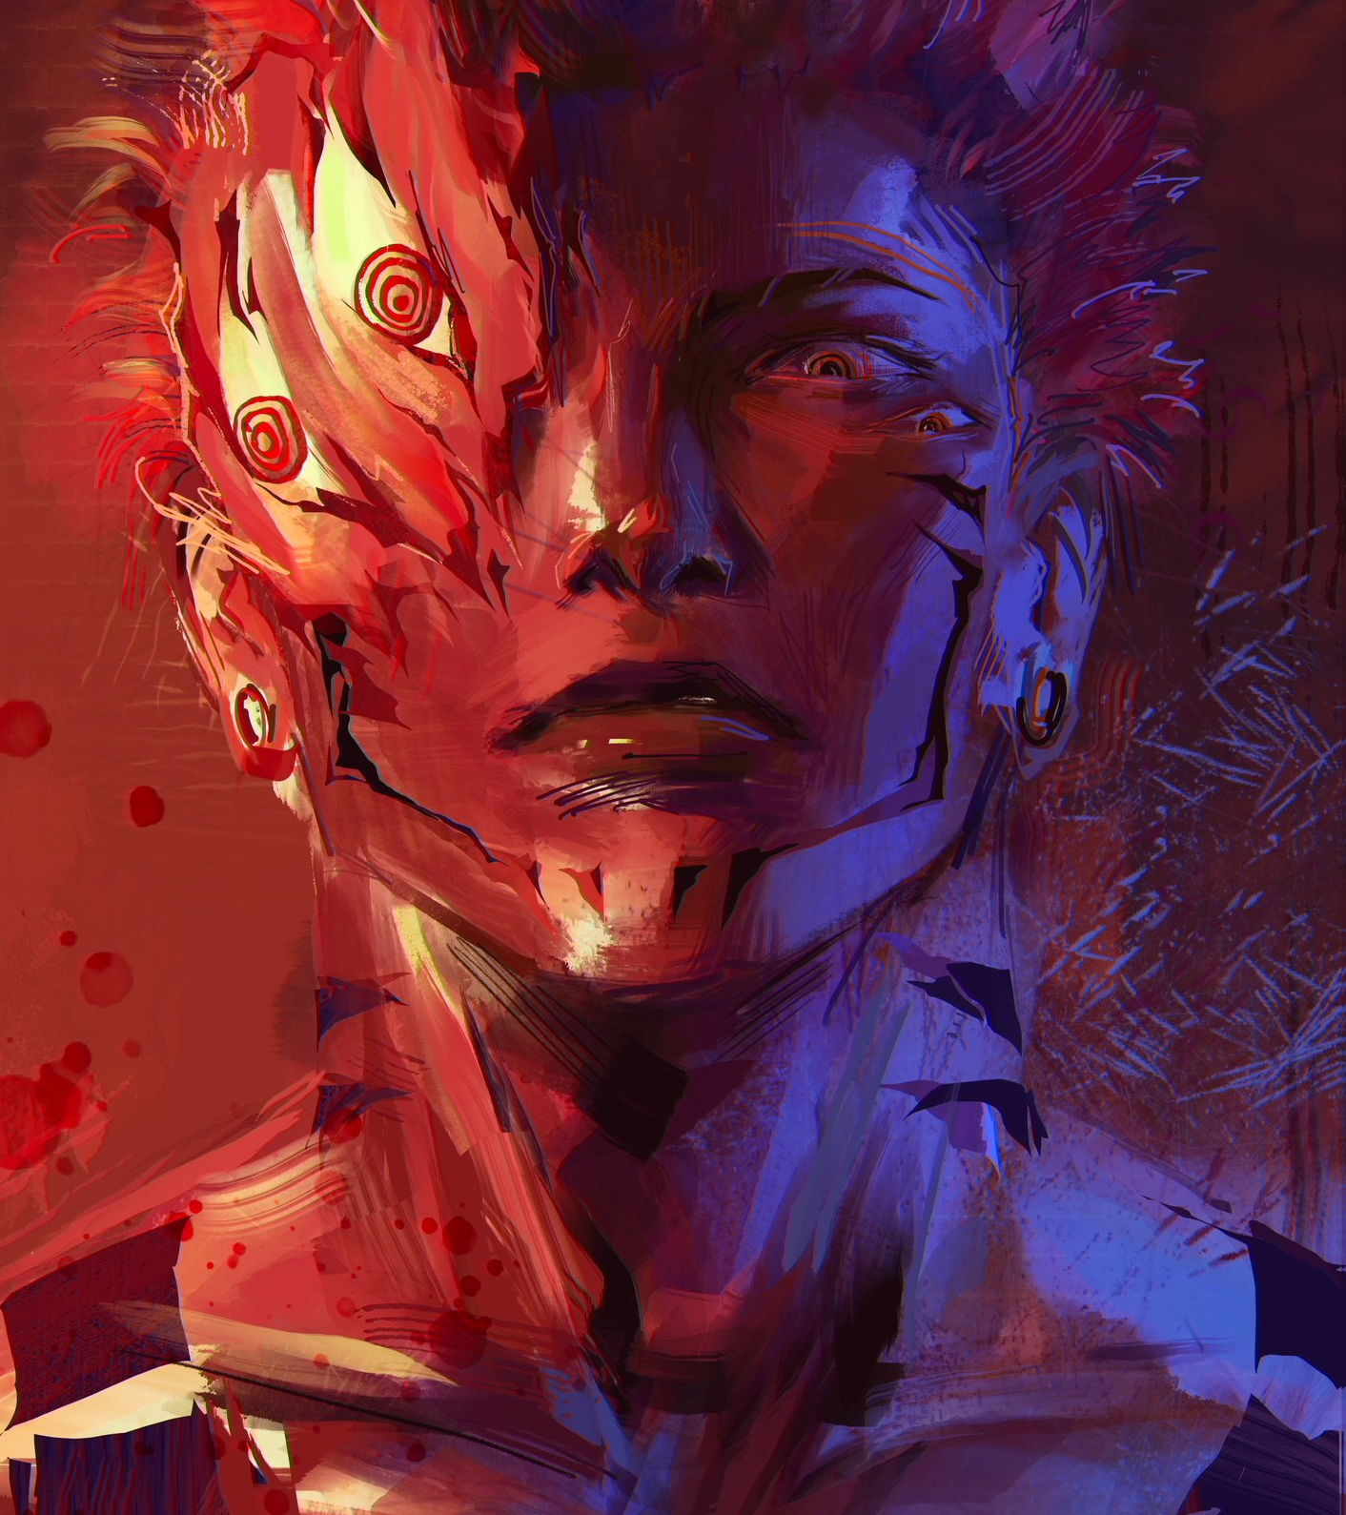
Unpredictable Nature and Lack of Allegiances
SUKUNA IS HIGHLY UNPREDICTABLE. UNLIKE MANY OTHER POWERFUL CURSES IN JUJUTSU KAISEN, WHO OFTEN JOIN ALLIANCES OR FOLLOW LEADERS, SUKUNA HAS NO LOYALTY TO ANYONE. HE IS ENTIRELY SELF-SERVING, MAKING HIS ACTIONS DIFFICULT TO PREDICT. WHILE OTHER CURSES MAY ACT OUT OF INSTINCT OR FOLLOW A SET GOAL, SUKUNA OPERATES ACCORDING TO HIS WHIMS AND DESIRES, DRIVEN BY A LOVE FOR VIOLENCE, DESTRUCTION, AND CHAOS. HIS PRIMARY MOTIVATION SEEMS TO BE AMUSEMENT AND HIS OWN GAIN, NOT CONQUEST OR POLITICAL POWER AMONG CURSES.

Slide 9
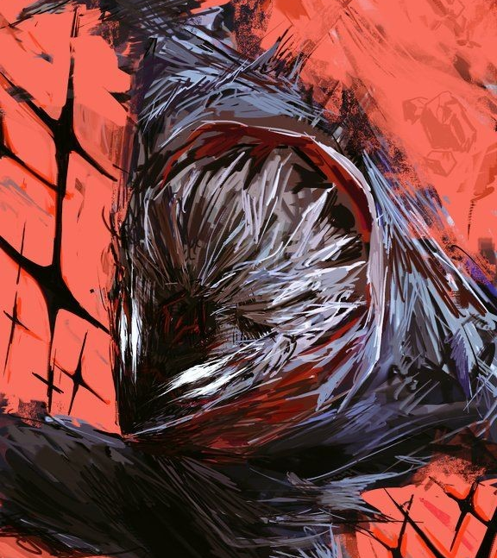
SUKUNA'S UNKNOWN TRUE POTENTIAL ALTHOUGH SUKUNA IS ALREADY IMMENSELY POWERFUL WITH ONLY A FEW OF HIS FINGERS INGESTED BY YUJI, THERE’S A LINGERING QUESTION OF WHAT HIS FULL POWER WOULD LOOK LIKE IF ALL 20 FINGERS WERE GATHERED. HIS RESURRECTION AT FULL STRENGTH IS CONSIDERED A CATACLYSMIC EVENT, ONE THAT COULD POTENTIALLY SHIFT THE ENTIRE BALANCE OF POWER IN THE WORLD OF JUJUTSU SORCERY. SUKUNA’S POWER IS FEARED NOT ONLY BY SORCERERS BUT ALSO BY CURSES. HE IS REGARDED AS AN ANCIENT AND TIMELESS FORCE THAT MODERN CURSES, NO MATTER HOW POWERFUL, CANNOT COMPARE TO. IF ALL OF SUKUNA’S POWER WERE TO BE FULLY UNLEASHED, IT IS UNCLEAR WHETHER ANY SORCERER OR EVEN MULTIPLE HIGH-LEVEL SORCERERS COULD DEFEAT HIM.

Slide 10
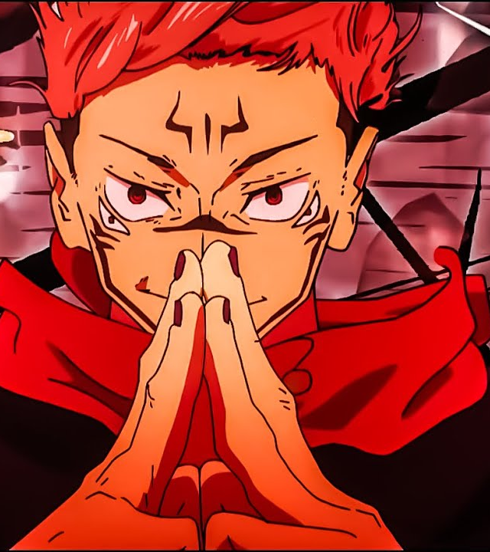
The Unique Relationship WITH YUJI ITADORI
SUKUNA’S RELATIONSHIP WITH YUJI ITADORI IS COMPLEX. WHEN YUJI CONSUMES ONE OF SUKUNA’S FINGERS, SUKUNA’S CONSCIOUSNESS IS RESURRECTED WITHIN YUJI’S BODY. THIS SETS UP A DYNAMIC WHERE SUKUNA CAN OCCASIONALLY TAKE CONTROL OF YUJI’S BODY, BUT ONLY UNDER CERTAIN CONDITIONS. UNLIKE TYPICAL CURSES, SUKUNA DOESN'T JUST TAKE OVER YUJI'S BODY BY FORCE; HE CHOOSES HIS MOMENTS CAREFULLY AND NEGOTIATES WITH YUJI, REVEALING HIS CUNNING AND PATIENCE.
THIS BOND PRESENTS A UNIQUE PROBLEM: WHILE YUJI IS A VESSEL FOR SUKUNA, HE ALSO POSSESSES REMARKABLE RESISTANCE TO SUKUNA’S FULL CONTROL. THIS AMUSES SUKUNA, WHO SEES YUJI AS A CURIOSITY, FURTHER ADDING COMPLEXITY TO THEIR HOST-PARASITE RELATIONSHIP.

Slide 11
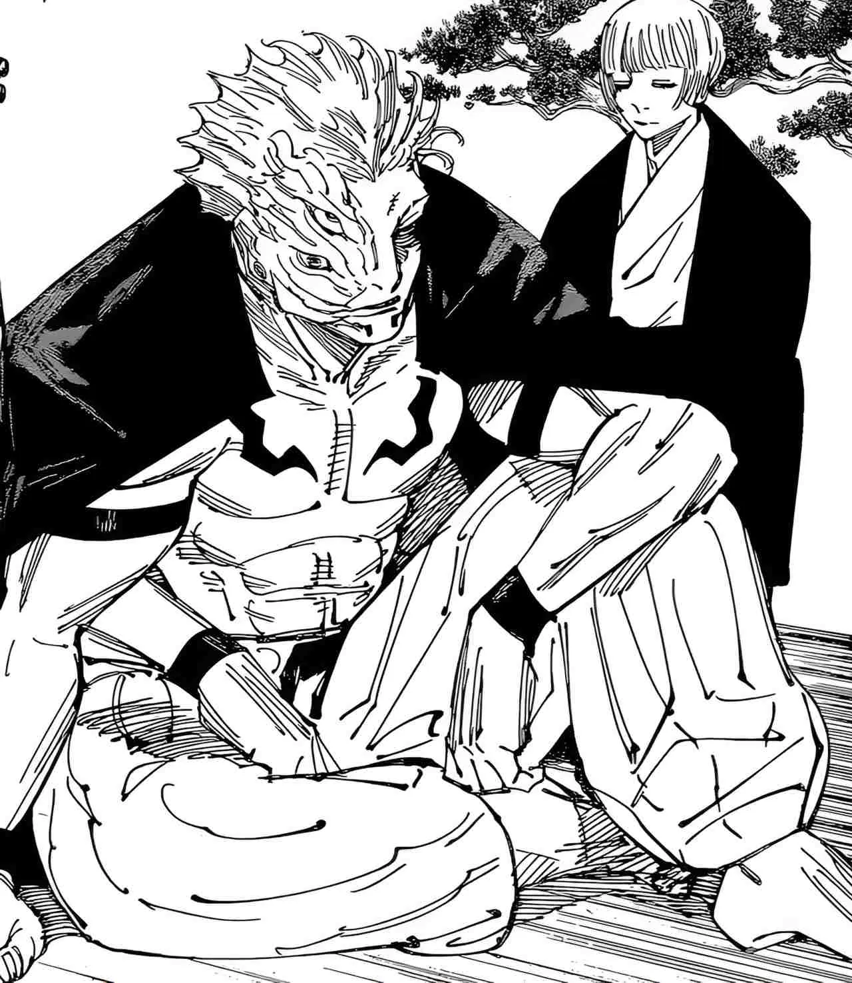
SUKUNA'S INFLUENCE AND IMPACT IN THE HEIAN ERA THE HEIAN ERA, WHEN SUKUNA WAS ALIVE, WAS CONSIDERED A TIME WHEN SORCERY WAS AT ITS ZENITH, AND CURSED SPIRITS FLOURISHED. SUKUNA WAS NOT JUST A SORCERER, BUT A SYMBOL OF ABSOLUTE DOMINANCE OVER LIFE AND DEATH. HE DEFIED THE NORMS OF THE ERA, OFTEN TREATED LIKE A GOD BY THOSE WHO FEARED HIM AND A DEMON BY THOSE WHO SOUGHT TO DESTROY HIM HIS ABILITIES WENT FAR BEYOND MERE COMBAT PROWESS. SUKUNA WAS ALSO ADEPT IN CURSED TECHNIQUES THAT OTHERS COULD NOT HOPE TO REPLICATE. HIS DEEP UNDERSTANDING OF THESE TECHNIQUES ALLOWED HIM TO MANIPULATE CURSED ENERGY IN WAYS THAT DEFIED REASON, GIVING HIM NEAR-UNLIMITED DESTRUCTIVE POTENTIAL.

Slide 12
SUKUNA’S MASTERY OF JUJUTSU TECHNIQUES THOUGH HIS DOMAIN EXPANSION, MALEVOLENT SHRINE, IS HIS SIGNATURE TECHNIQUE, SUKUNA IS LIKELY CAPABLE OF MUCH MORE. HIS UNDERSTANDING OF CURSED ENERGY MANIPULATION EXCEEDS THAT OF MODERN SORCERERS. HIS TECHNIQUES ARE BELIEVED TO BE INTRICATE AND COMPLEX, CRAFTED DURING THE TIME WHEN JUJUTSU WAS IN ITS PRIME. HE USES CLEAVER-BASED SLASHING ATTACKS THAT CAN DISSECT HIS ENEMIES WITH FRIGHTENING PRECISION, INDICATING THAT HIS POWER IS NOT JUST RAW STRENGTH BUT REFINED MASTERY OF HIS ABILITIES. THERE ARE ALSO IMPLICATIONS THAT SUKUNA MAY POSSESS OTHER ADVANCED TECHNIQUES THAT HAVEN’T BEEN FULLY REVEALED YET. HE APPEARS TO HAVE ACCESS TO A WIDE RANGE OF CURSED ABILITIES THAT FEW OTHERS CAN RIVAL.

Slide 13
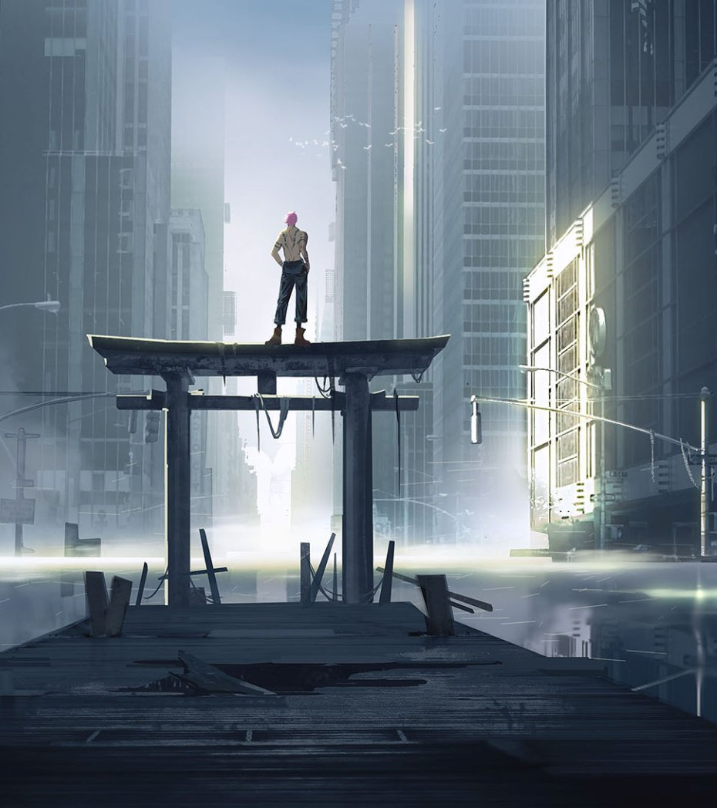
SUKUNA'S EGO AND GODLIKE COMPLEX ONE OF SUKUNA'S DEFINING TRAITS IS HIS TOWERING EGO. HE SEES HIMSELF AS ABOVE ALL OTHERS, AND HIS GODLIKE COMPLEX REFLECTS HIS DESIRE FOR ABSOLUTE DOMINANCE. HE LOOKS DOWN ON EVERYONE, BE THEY HUMANS, SORCERERS, OR CURSES. THIS SUPREME ARROGANCE MAKES HIM DISMISSIVE OF BOTH FRIENDS AND FOES, AS HE DOESN'T BELIEVE ANYONE IS WORTHY ENOUGH TO STAND IN HIS PRESENCE. SUKUNA DOES NOT ALIGN CHAOTIC FORCE THAT LIVES FOR BATTLE, DESTRUCTION, AND PROVING HIS SUPERIORITY OVER ALL LIVING THINGS. THIS IMMENSE EGO ALSO PLAYS INTO HIS ENJOYMENT OF TORMENTING YUJI. SUKUNA KNOWS THAT YUJI RESISTS HIM, AND HE TAKES PLEASURE IN DEMONSTRATING HIS POWER BY DOING THINGS THAT YUJI DESPISES, SUCH AS MERCILESSLY KILLING OPPONENTS OR MANIPULATING SITUATIONS TO CREATE CHAOS.

Slide 14
IN SUMMARY, RYOMEN SUKUNA IS MORE THAN JUST A POWERFUL CURSED SPIRIT; HE IS A FORCE OF NATURE, AN ANCIENT EVIL WHOSE POWER TRANSCENDS TIME, AND A CHARACTER WHOSE TRUE POTENTIAL IS STILL UNFOLDING. HIS INDOMITABLE WILL, GODLIKE COMPLEX, AND MASTERY OF CURSED ENERGY MAKE HIM A CHARACTER OF IMMENSE INTRIGUE AND DANGER WITHIN THE WORLD OF JUJUTSU KAISEN.
POTENTIAL FUTURE ROLE IN THE SERIES
SUKUNA'S ROLE IN THE FUTURE OF JUJUTSU KAISEN IS HIGHLY ANTICIPATED. AS MORE OF HIS FINGERS ARE FOUND AND CONSUMED, HIS INFLUENCE OVER YUJI GROWS, SUGGESTING THAT THERE MAY BE A TIPPING POINT WHERE SUKUNA COULD TAKE COMPLETE CONTROL. HIS ULTIMATE GOAL REMAINS SHROUDED IN MYSTERY, BUT IT IS CLEAR THAT HE ENJOYS TOYING WITH THE WORLD AROUND HIM, AND HIS FULL RESURRECTION WOULD LIKELY BRING UNTOLD CHAOS TO THE JUJUTSU WORLD.

Slide 15
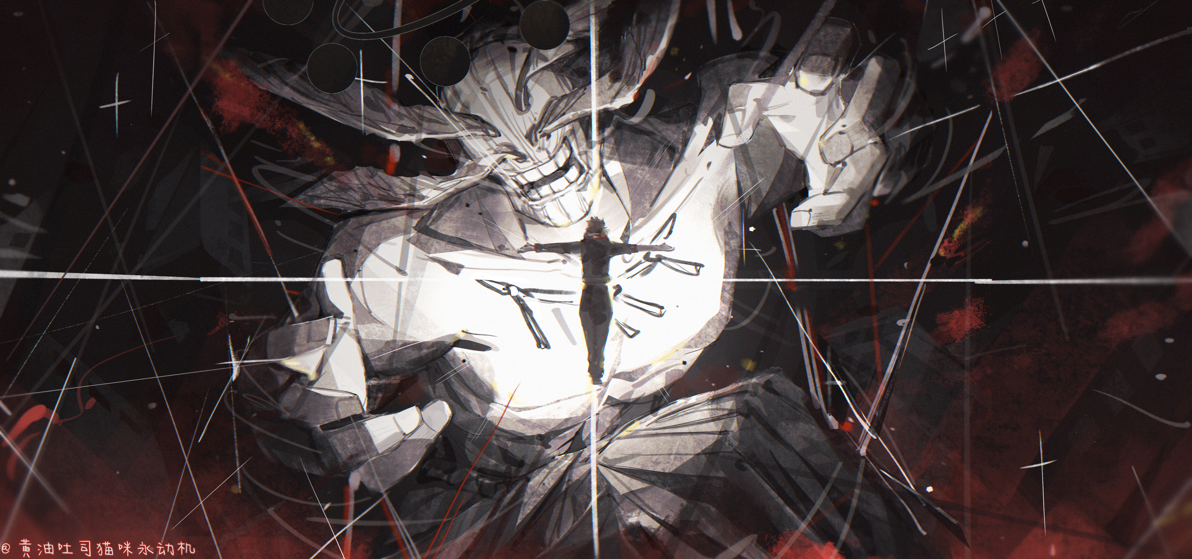
RYOMEN SUKUNA ( 856-2018 ) RYOMEN SUKUNA, THE KING OF CURSES, FELL IN THE END, BUT HIS LEGACY OF TERROR ENDURES. THE WORLD MAY BREATHE, BUT THE SHADOW OF HIS POWER REMAINS, WAITING FOR THOSE FOOLISH ENOUGH TO SEEK IT.

Slide 16
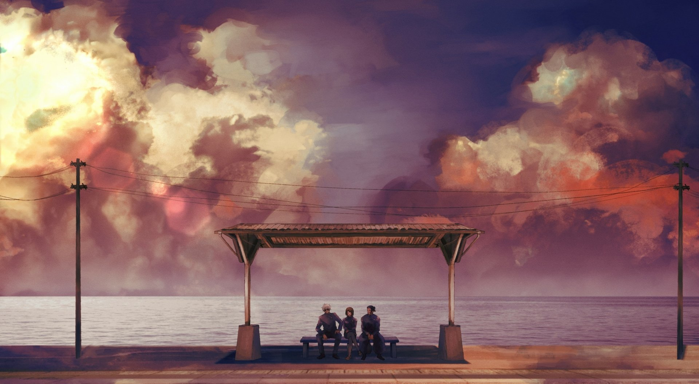
Thank you Everyone

